Slide 1
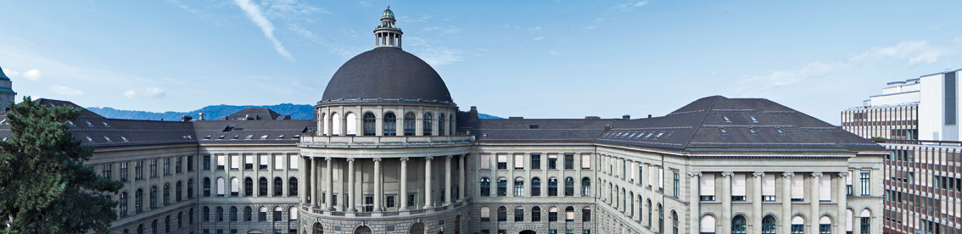
Modelling the evolution of human trail systems Dirk Helbing, Joachim Keltsch & Péter Molnár
Is the model is capable of reflecting trail systems that emerged in the real world?
Team FreeWalk: Robin Stähli, Christoph Martin, Lukas Bircher

Slide 2
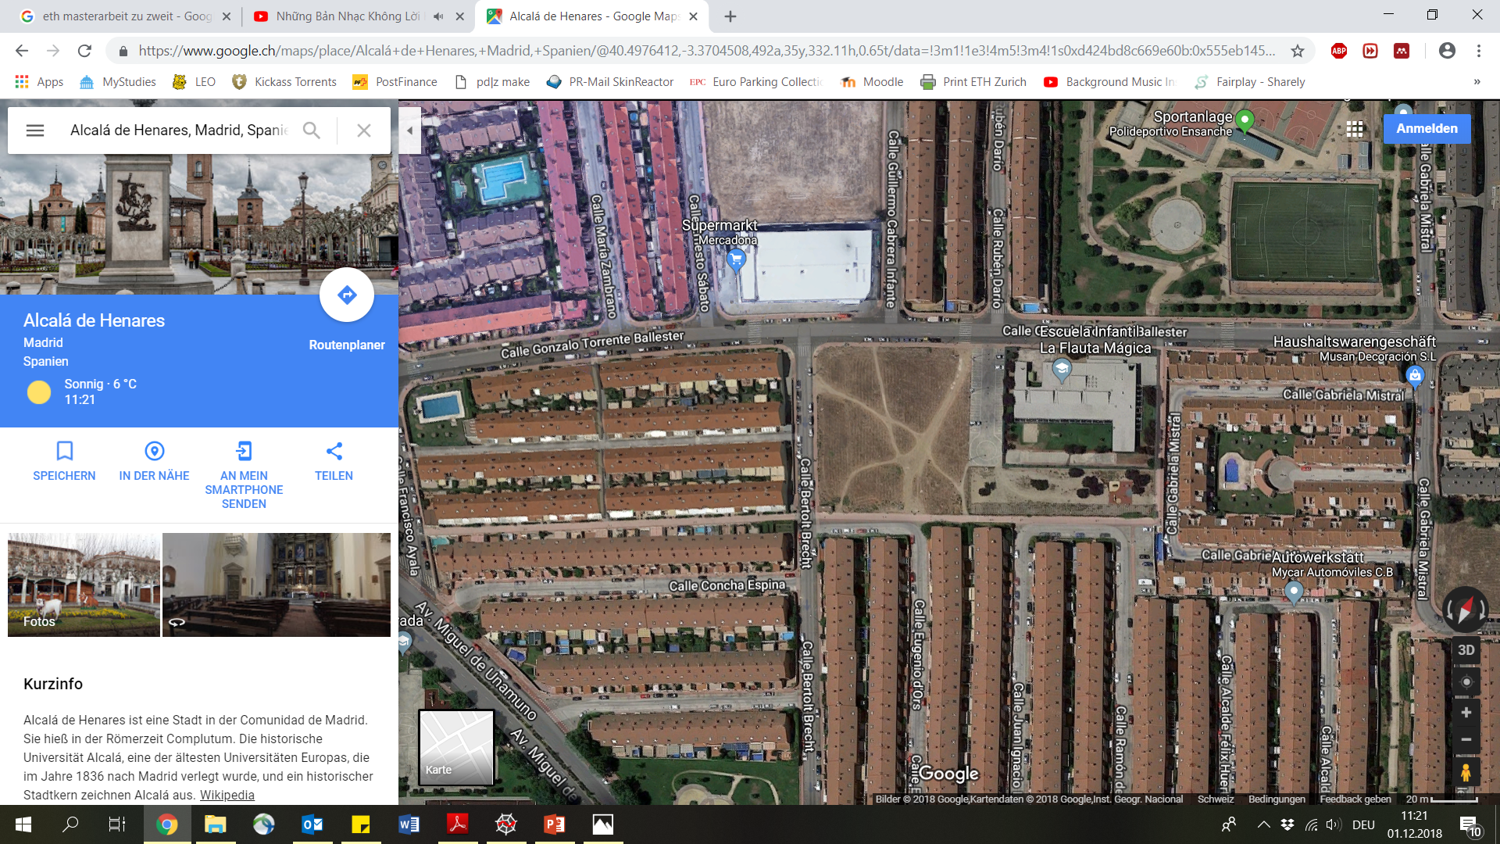
Trails in urban “green” space such as parks
University Campus Stuttgart Germany
Park in Alcalá (Madrid, Spain)

Slide 3


Implementation of Model
new field old field
old position
new position

Slide 4

Trail development
$\frac{dG\left(r,T\right)}{dt}=\frac{1}{T}\left[G_{0}\left(r\right)−G\left(r,t\right)\right]+I\left[1−\frac{G\left(r,t\right)}{G_{max}\left(r\right)}\right]\sum_{α}{δ(r−r_{α\left(t\right)})}$
Ground modification
Ground regeneration
Ground distraction form pedestrian
$$+ \frac{dG\left(r,T\right)}{dt}$$

Slide 5

Trail/destination attraction
${∇_{rα}V}_{tr}\left(r_{α},t\right)=∇_{rα}∫d^{2}re^{\frac{\left|r−r_{α}\right|}{σ}}G\left(r,t\right)$
$e_{α}\left(r_{α}\right)=d_{alpha}−r_{α}$
Attraction of trails
Attraction of destination

Slide 6

Walking direction
$e_{α}\left(r_{α},t\right)=\frac{1.5 ∗ \frac{d_{alpha}−r_{α}}{\left|d_{alpha}−r_{α}\right|} + \frac{∇_{rα}V_{tr}\left(r_{α},t\right)}{\left|∇_{rα}V_{tr}\left(r_{α},t\right)\right|}}{\left|d_{alpha}−r_{α}\right|+ \left|∇_{rα}V_{tr}\left(r_{α},t\right)\right|}$
Walking direction
$+$ $e_{α}\left(r_{α},t\right)$

Slide 7
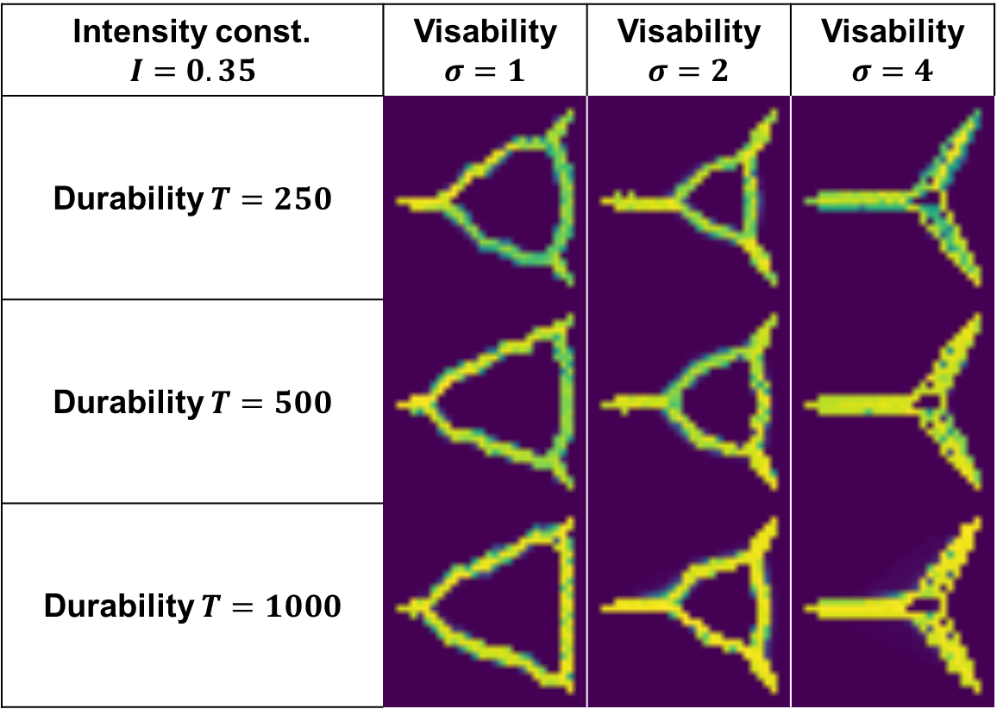
Direct- vs. Minimal way systems
Intensity const. $$I=0.35$$ | Visability $σ=1$ | Visability $σ=2$ | Visability $σ=4$
Durability $T=250$
Durability $T=500$
Durability $T=1000$
Notes:
More depanding on sigma than on other factors
As can be read in the paper the model evaluates direct or minimal way systems depending on the parameter. Model works like in paper shown.

Slide 8
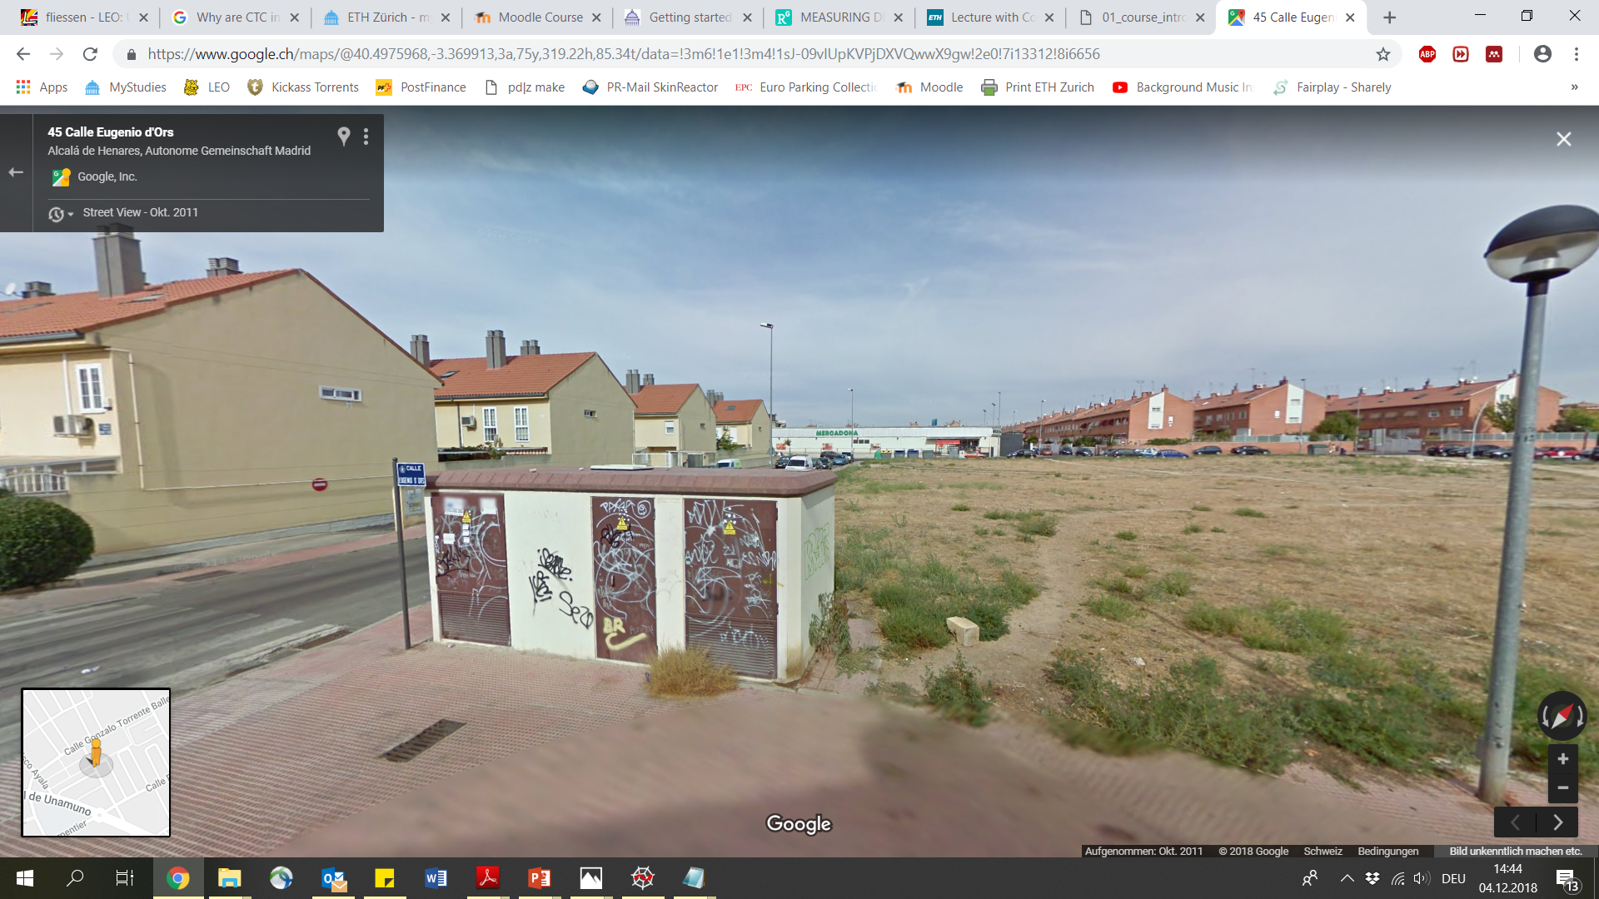
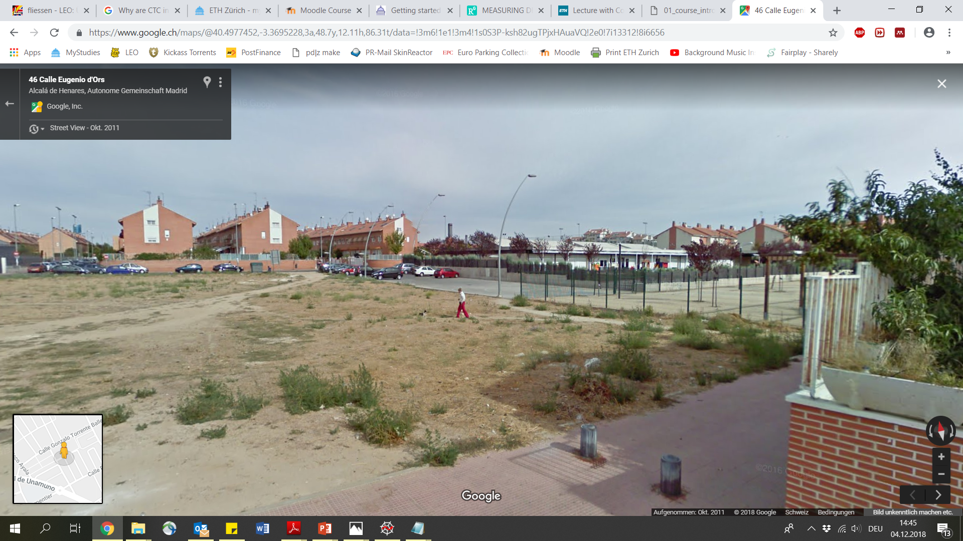
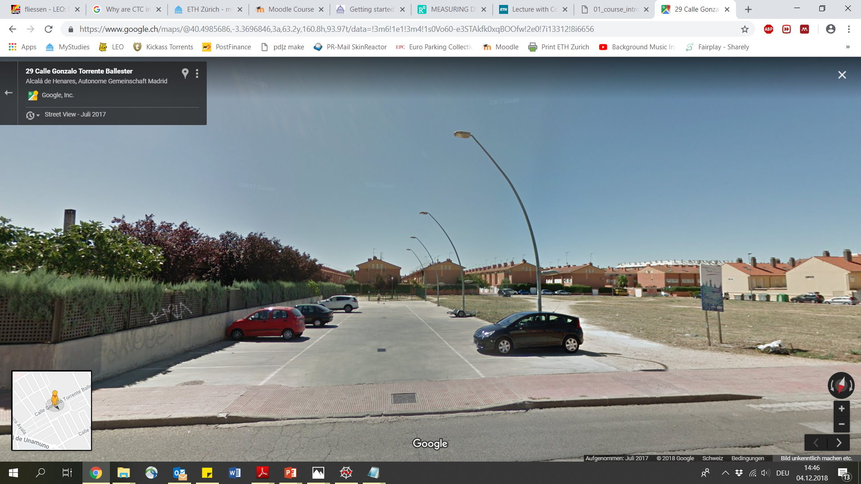
Environmental boundary condition
Pavement around park
Parking space
Fence
House
Notes:
More depanding on sigma than on other factors
As can be read in the paper the model evaluates direct or minimal way systems depending on the parameter. Model works like in paper shown.

Slide 9
Pedestrian distribution
Residential zone, accesses to super market
Accesses to super market, small residential zone, pre school
6
1
5
Residential zone
Big sport area, way to bus station
2
4
Residential zone, way to train station
3
Residential zone
Notes:
More depanding on sigma than on other factors
As can be read in the paper the model evaluates direct or minimal way systems depending on the parameter. Model works like in paper shown.

Slide 10


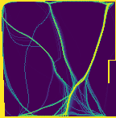


Trail evolution starting form green field
Starting field
Existing trails
σ = 3
σ = 6
σ = 12
Notes:
More depanding on sigma than on other factors
As can be read in the paper the model evaluates direct or minimal way systems depending on the parameter. Model works like in paper shown.

Slide 11


Trail evolution starting form actual trail systems
Starting field
σ = 3
σ = 6
σ = 12
Notes:
More depanding on sigma than on other factors
As can be read in the paper the model evaluates direct or minimal way systems depending on the parameter. Model works like in paper shown.

Slide 12
Discussion
Pavement around park
Pavement around park
Parking space
Parking space
Fence
Fence
House
House
Notes:
More depanding on sigma than on other factors
As can be read in the paper the model evaluates direct or minimal way systems depending on the parameter. Model works like in paper shown.

Slide 13
Conclusion
The code seems to be applicable to reality
Model parameter are difficult to identify
Better estimation methods for pedestrian distribution could be applied
Notes:
More depanding on sigma than on other factors
As can be read in the paper the model evaluates direct or minimal way systems depending on the parameter. Model works like in paper shown.

Slide 14

Visualisation of trail evolution
Notes:
More depanding on sigma than on other factors
As can be read in the paper the model evaluates direct or minimal way systems depending on the parameter. Model works like in paper shown.

Slide 15
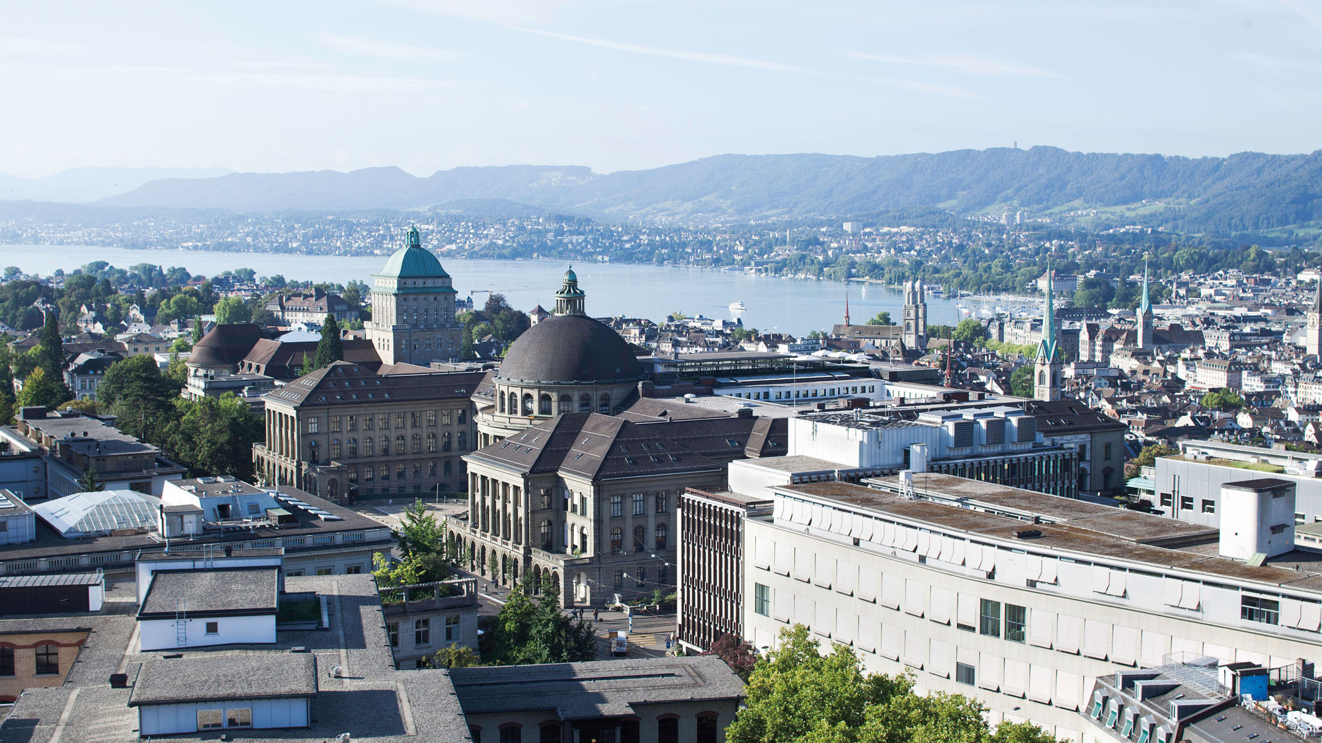
Questions?
?

Slide 16
Sources
Dirk Helbing, Joachim Keltsch & Péter Molnár. Modeling the evolution of human trail systems. Macmillan PublishersLtd, Nature, 1997
Notes:
More depanding on sigma than on other factors
As can be read in the paper the model evaluates direct or minimal way systems depending on the parameter. Model works like in paper shown.

Slide 17
Outlook
Differences of height in the ground
Fixed, unpassable obstacles
Notes:
More depanding on sigma than on other factors
As can be read in the paper the model evaluates direct or minimal way systems depending on the parameter. Model works like in paper shown.

Slide 18
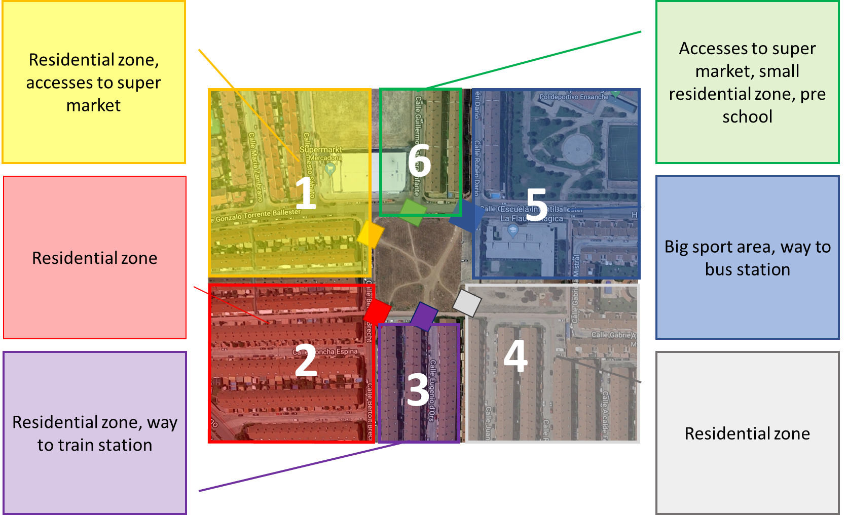
Pedestrian distribution
2 Spawn-Point
2 Spawn-Point
2 Spawn-Point
8 Spawn-Point
8 Spawn-Point
2 Spawn-Point
Notes:
More depanding on sigma than on other factors
As can be read in the paper the model evaluates direct or minimal way systems depending on the parameter. Model works like in paper shown.

